Slide 1
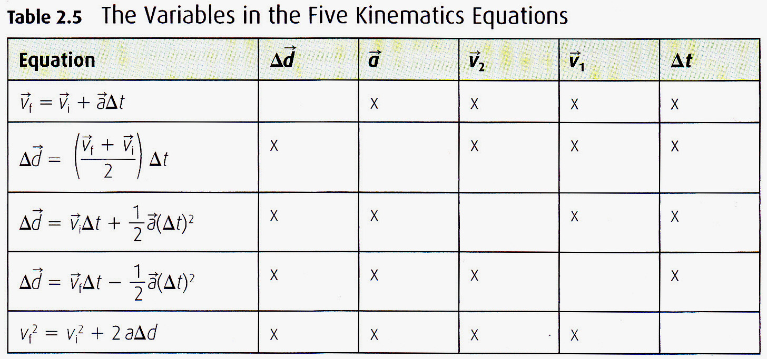
All Five Equations
There are five main variables (thus five equations)
Each equation includes four variables
Each equation is missing one variable

